Slide 1
Programming with JavaScript and jQuery
Day 8

Slide 2
Using Touch Events and Pointer Events
On touchscreen device without a mouse
browsers fire click event when user touches screen
Other events don't translate neatly for touchscreens
What other events can be captured from a desktop computer with a mouse?

Slide 3
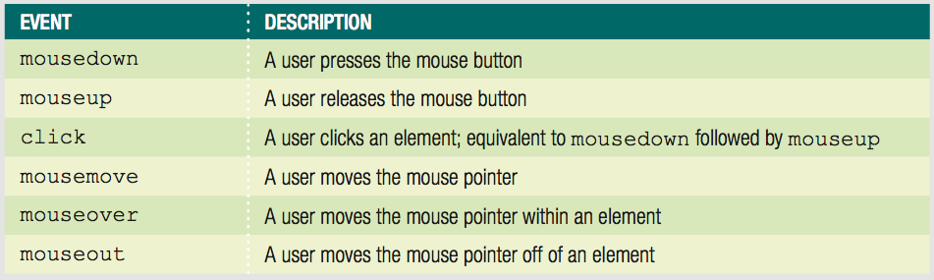
Creating a Drag-and Drop Application with Mouse Events
Mouse events
events based on actions of mouse or touchpad
Table 10-1 Mouse events

Slide 4
Understanding Mouse Events on a Touchscreen Device
On a touchscreen device
Some web page elements respond to mouse events
div element not considered clickable
doesn't fire mouse events on touchscreen
links and form elements are clickable
browsers respond to touch
Touch cascade
Browser checks a touched element for an event handler for multiple events
Including some mouse events

Slide 5
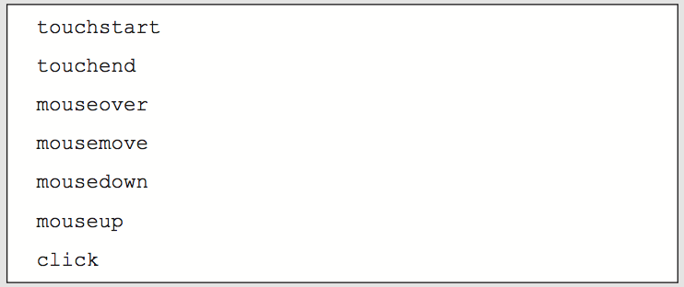
Understanding Mouse Events on a Touchscreen Device
Figure 10-5 Touch cascade order

Slide 6
Understanding Mouse Events on a Touchscreen Device
Touchscreen devices fire touchscreen-specific events for some elements
Touch events created by Apple
Used on Apple iOS and Google Android
Pointer events created by Microsoft
Used on Windows Phone and Windows 8 and higher

Slide 7
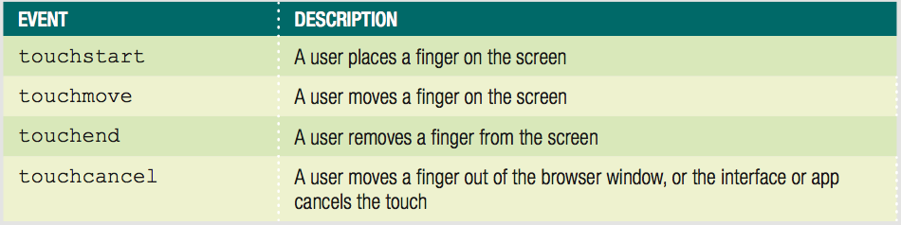
Implementing Touch Events
Respond to user's finger touches on a touchscreen
Table 10-2 Touch events

Slide 8
Implementing Touch Events
touchstart event
analogous to mousedown mouse event
touchmove event
corresponds to mousemove
touchend event
similar to mouseup
touchcancel event
unique to touchscreen

Slide 9
Implementing Touch Events
Working with Touch Coordinates
Mouse events can work with event properties
clientX property = x coordinate of event
clientY property = y coordinate of event
Touch events support multitouch devices
Allow for multiple touches on screen at once
Don't support clientX or clientY properties as direct children
Each touch event has array properties
What is an array?

Slide 10
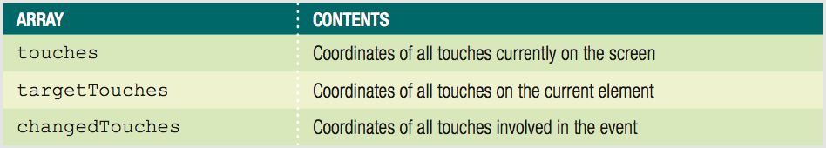
Implementing Touch Events
Table 10-3 Array properties of touch events

Slide 11
Implementing Touch Events
Distinguishing Between App and Device Interaction
Touchscreen devices use touch events for more than one purpose
Can interact via touch with an app
Use touch to perform gestures
Browser and device interactions like scrolling
Use preventDefault() method
Ensures that OS interface doesn't respond to events when users interact with your app

Slide 12
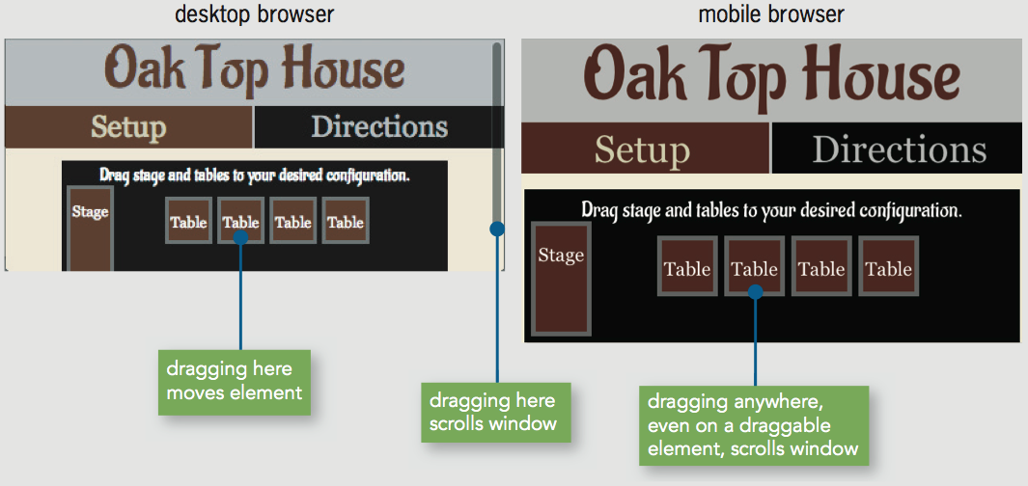
Implementing Touch Events
Figure 10-7 Multiple uses of a single touch event

Slide 13
Implementing Pointer Events
Touchscreens on new types of devices
Tablets
Notebook computers
Makes coding for touch and mouse events more complicated
Some devices support stylus input
Some devices have trackpads

Slide 14
Implementing Pointer Events
Microsoft pointer events
Aim to handle input from mouse, finger, or stylus with each event
Incorporate other event properties
Pressure on screen
Angle of stylus
Only IE Mobile and IE 10 and later support pointer events
Some versions of IE do not recognize touch events
Use mouse+touch+pointer for max. compatibility

Slide 15
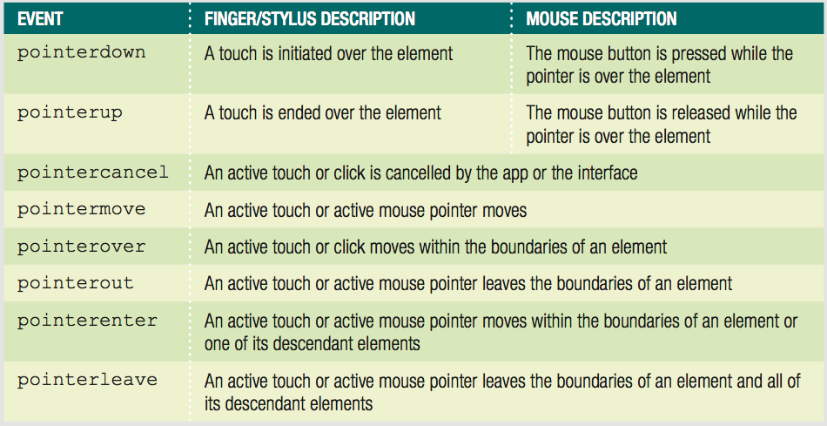
Implementing Pointer Events
Table 10-4 Pointer events

Slide 16
Implementing Pointer Events
Identifying pointer screen coordinates
clientX and clientY properties like mouse events
Stopping OS gestures
Requires setting msTouchAction CSS property
Set value to none

Slide 17
Exercise
Review the tutorial at http://www.javascriptkit.com/javatutors/touchevents.shtml and implement the exercise.
Upload the exercise to your server and test it from a touch screen device.

Slide 18
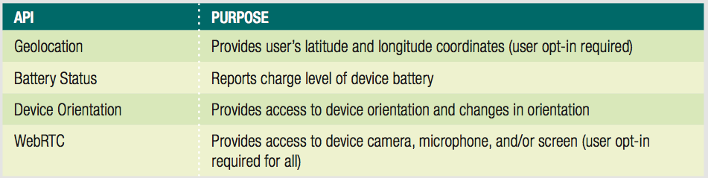
Using Programming Interfaces for Mobile Devices
APIs available to access information provided by mobile device hardware
Table 10-5 Selected hardware APIs for mobile devices

Slide 19
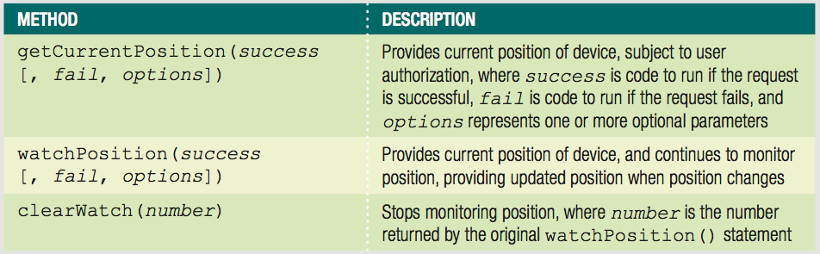
Using the Geolocation API
Provides access to user's latitude & longitude
Accessed using geolocation property of Navigator object
Table 10-5 Selected hardware APIs for mobile devices

Slide 20
Using the Geolocation API
Callbacks
Arguments that contain/reference executable code
getCurrentPosition() method
Request user's position a single time

Slide 21
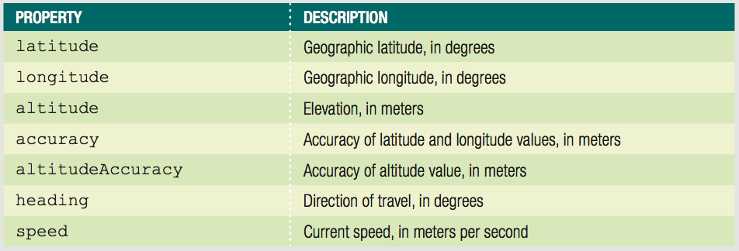
Using the Geolocation API
Table 10-7 Properties passed on a successful geolocation request

Slide 22
Using the Geolocation API
Basic example:
navigator.geolocation.getCurrentPosition(showLocation);
function showLocation(position) {
console.log("Longitude: " + position.coords.longitude);
console.log("Latitude: " + position.coords.latitude);
}

Slide 23
Using the Geolocation API
Enhanced example
Handle failed request, set 10-second timeout:
navigator.geolocation.getCurrentPosition(showLocation, fail, {timeout: 10000});
function showLocation(position) {
console.log("Longitude: " + position.coords.longitude);
console.log("Latitude: " + position.coords.latitude);
}
^{function fail() {}
var content = document.getElementById("mainParagraph");
content.innerHTML = "<p>Geolocation information not
available or not authorized.</p>";
}

Slide 24
Using the Geolocation API
Need to fail gracefully in older browsers
^{if (navigator.geolocation {}
navigator.geolocation.getCurrentPosition(createDirections, fail, {timeout: 10000});
^{} else {}
^{fail();}
}

Slide 25
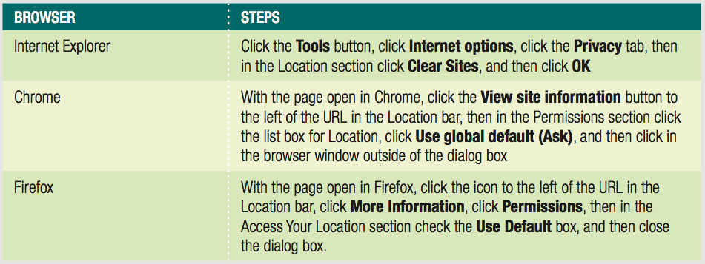
Using the Geolocation API
Need to clear geolocation history for testing
Table 10-9 Steps to clear saved geolocation history

Slide 26
Using the Geolocation API
Sometimes users don't notice or ignore geolocation request
Request neither fails or succeeds
Any dependent code not executed

Slide 27
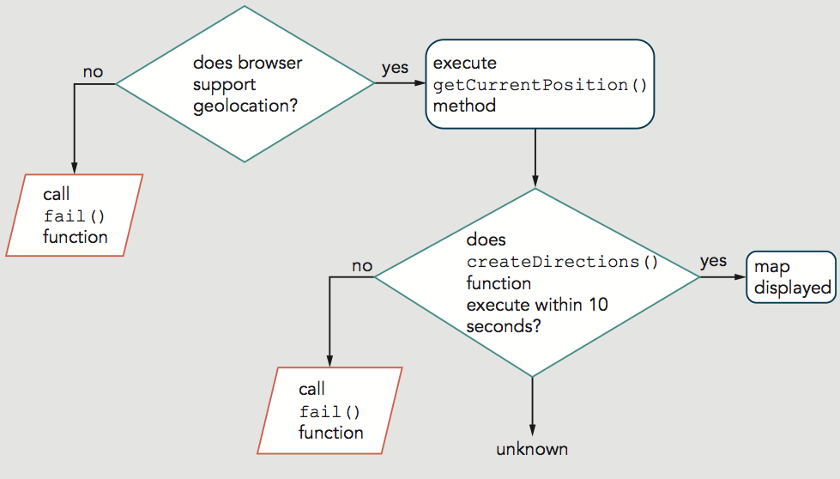
Using the Geolocation API
Figure 10-10 Flowchart illustrating flow of current geolocation code

Slide 28
Using the Geolocation API
Can handle lack of yes/no response from user
setTimeout() method
Start countdown before request
If timeout expires, stop waiting and trigger failure code
If user responds, cancel timeout

Slide 29
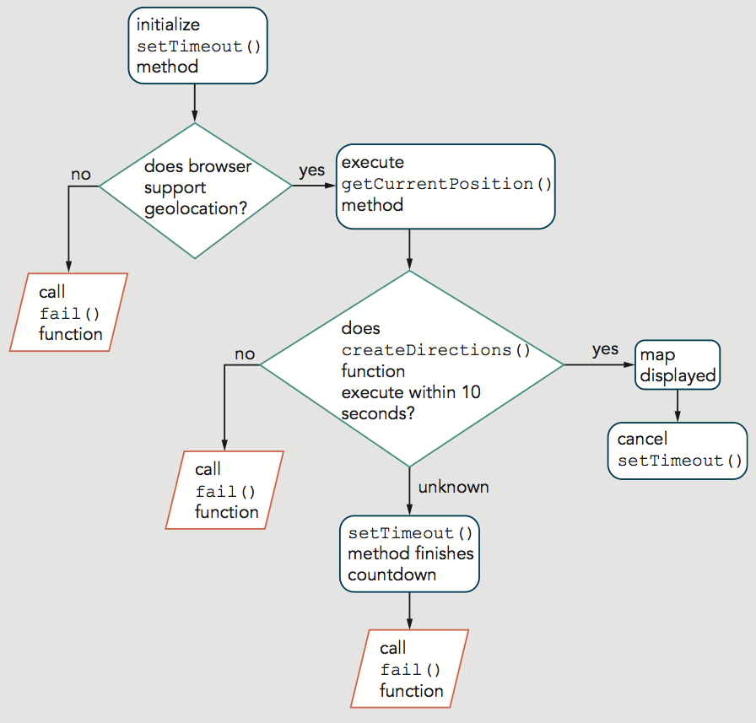
Using the Geolocation API
Figure 10-11 Flowchart illustrating geolocation code that incorporates setTimeout()

Slide 30
Using the Geolocation API
Code complete to acquire geolocation information
Then you can integrate with databases
Using the Google Maps API
Can display a map centered on user's location
Can show route/directions between two locations
Includes 2 constructors
Map() creates a map object
var name = new google.maps.Map(element, options);
LatLng() creates an object containing coordinates
center: new google.maps.LatLng(latitude, longitude)

Slide 31
Using the Geolocation API
Using the Google Maps API
Example—create new map centered on current position with zoom of 11:
var currPosLat = position.coords.latitude;
var currPosLng = position.coords.longitude;
^{var mapOptions = {}
center: new google.maps.LatLng(currPosLat, currPosLng),
^{zoom: 11}
};
var map = new google.maps.Map(document.getElementById("map"), mapOptions);

Slide 32
Using the Geolocation API
Using the Google Maps API (cont'd.)
Can also create map centered on specified point
Geocoding
Converting physical address to latitude/longitude coordinates

Slide 33
Exercise
Get a Google API key from https://developers.google.com/maps/documentation/javascript/get-api-key
Implement the Hands On Project 10-3, page 735 in the textbook.
In step 6 (page 736) use the following script include (Google APIs have changed):
<script src="https://maps.googleapis.com/maps/api/js?callback=geoTest&key=<YOUR GOOGLE API KEY>"></script>
Upload your code to the server and test from both desktop and mobile devices.

Slide 34
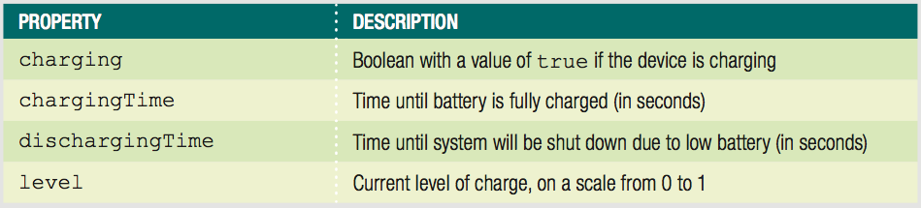
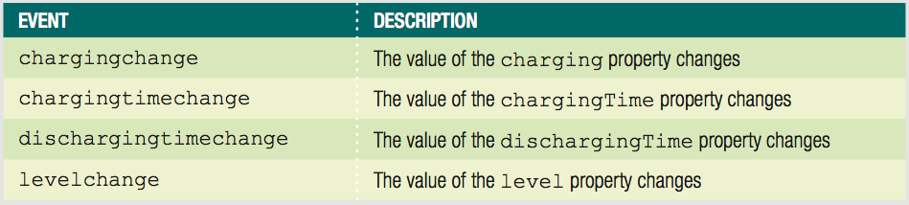
Using the Battery Status API
Adds a battery property to Navigator object
Table 10-10 Properties of the battery object
Table 10-11 Events of the battery object

Slide 35
Using the Device Orientation API
Provides access to changes in position and speed
Gyroscope
Device hardware that detects orientation in space
deviceorientation event
alpha, beta, and gamma coordinate properties
Accelerometer
Device hardware that detects changes in speed
devicemotion event
reports values for acceleration and rotation

Slide 36
Using the WebRTC API
Short for web real-time communication
Enables apps to
receive data from device camera and microphone
send and receive audio/video/data in real time
Should eventually allow text/video chat using only HTML and JavaScript

Slide 37
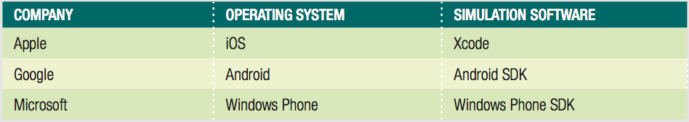
Enhancing Mobile Web Apps
Testing tools
Often impractical to collect many mobile devices
Online services available for testing
Free testing apps from mobile OS makers:
Table 10-12 Software used to simulate mobile devices

Slide 38
Enhancing Mobile Web Apps
Minimizing Download Size
Mobile speeds usually slower
Mobile users often have data caps

Slide 39
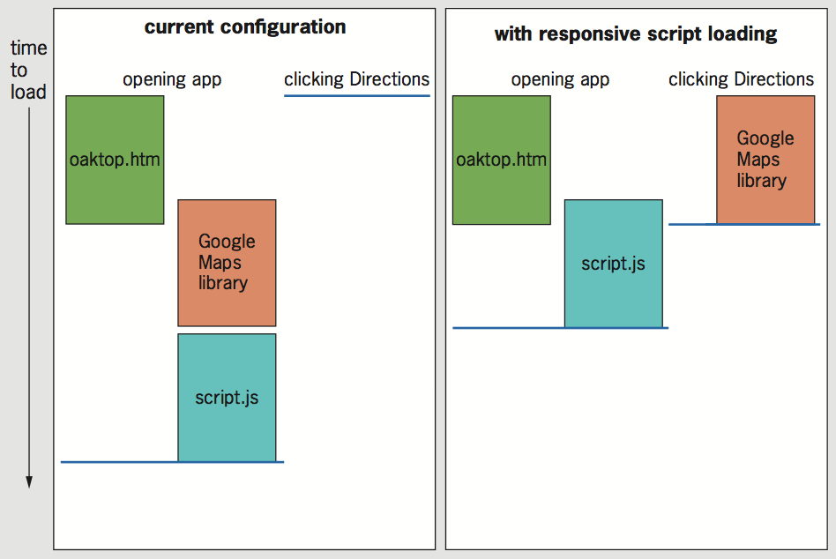
Enhancing Mobile Web Apps
Minimizing Download Size
Loading Scripts Responsively
Figure 10-14 Implementing responsive script loading for oaktop.htm

Slide 40
Enhancing Mobile Web Apps
Minifying Files
Removes comments, indents, and line breaks
Tweaks code in other ways to make it smaller
Online minifying services available

Slide 41
Summary
Touch events focus on responding to a user's finger touches on a touchscreen
To ensure OS interface doesn't respond to gestures
Use the preventDefault() method
Pointer events are different than touch events
Aim to handle input from mouse, finger, or stylus
Geolocation API provides access to a user's latitude and longitude coordinates
A number of tools exist for testing mobile web apps virtually
Important to minimize download size of mobile web app
Load scripts responsively
Minify files

Slide 42
Exercise
Enhance your web site project with a page that shows users their current location on the map.
Note that you must specify a height and width using CSS for the element in which you display the map; these dimensions can be any size you choose.
Also, enhance the page to display user’s latitude, longitude and altitude, with a label for each value.
Upload the new web page to the server and test from both desktop and mobile devices.

Slide 43
Homework
Enhance Lab 2 by adding Beijing, Paris and Rio de Janeiro (or any other cities of your choice) geolocations.
When the user clicks on the city label, the city should be shown on Google Map.
Detailed steps can be found in Hands on projects 10-4 and 10-5 on pages 737-738 of the textbook.

